Slide 1
CHAPTER 5
Chemical kinetics
5.1. What is chemical kinetics ?
Is the study of how fast chemical reactions occur
  speed or rate at which a reaction occurs
  How fast does the reaction go
  Some reactions are fast (e.g. photosynthesis)
  Some reactions are slow (e.g. conversion of diamond to graphite)

Slide 2
Rate of Reaction
Speed of a reaction is measured by the change in concentration with time.
The speed of different chemical reactions varies hugely.
  Some reactions are very fast and others are very slow.
The speed of a reaction is called the rate of the reaction.
Expressed as either:
  Rate of disappearance of reactants (decrease or negative)‏,Or
  Rate of appearance of products (increase or positive)

Slide 3
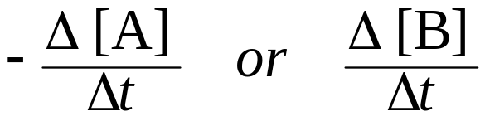
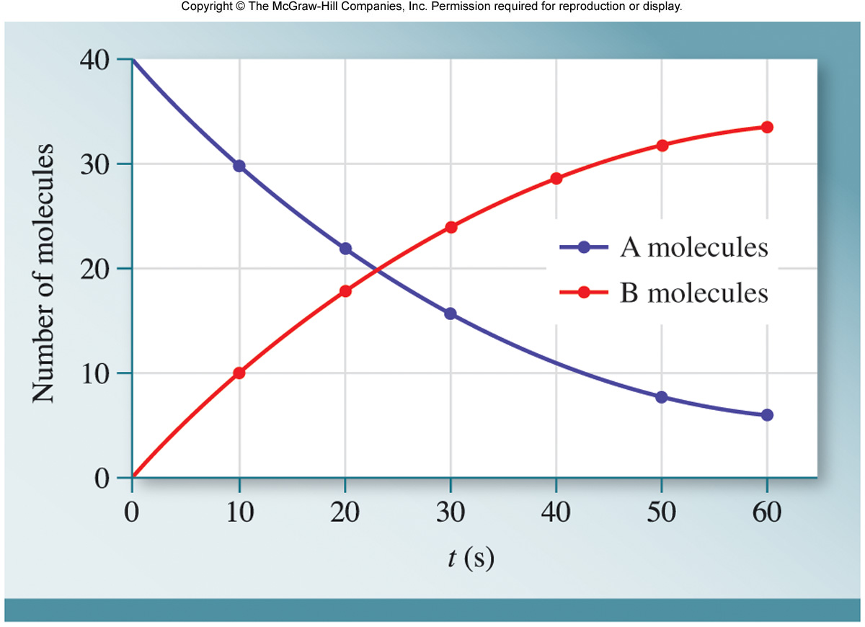
Average Reaction Rate
Average rate depends on time interval
Equation A → B; rate =
Why the negative on [A]?

Slide 4
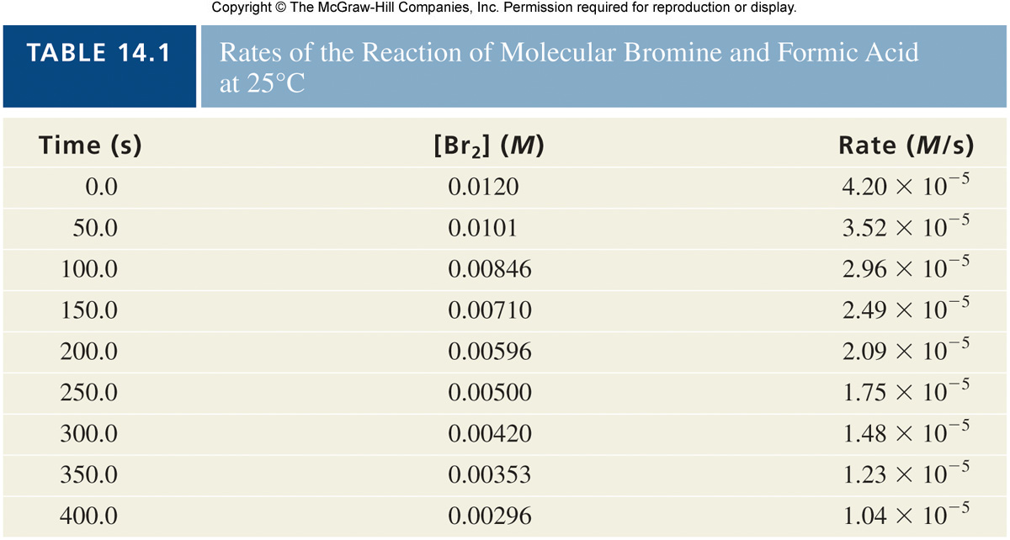
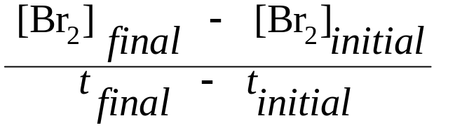
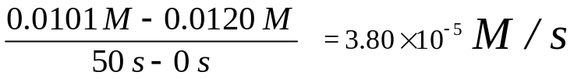
Example: Br₂(aq) + HCOOH(aq) → 2Br⁻(aq) + 2H⁺(aq) + CO₂(g)‏
Table 5.1
Calculate Average Rate at time of 50secods
Avg. rate =
=

Slide 5
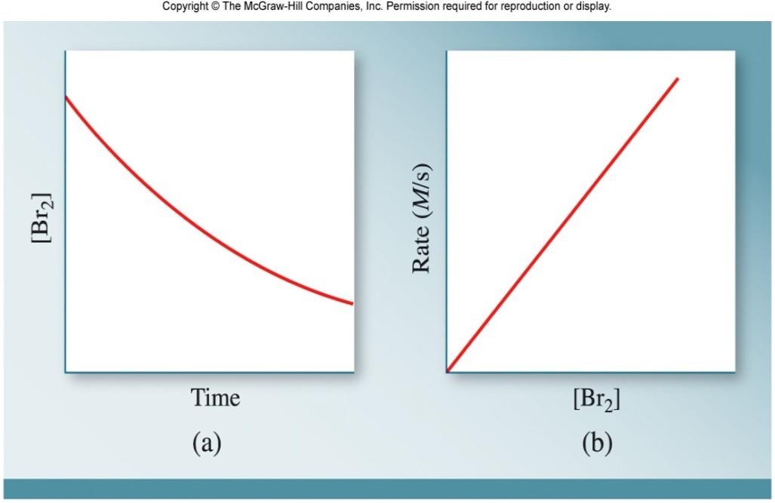
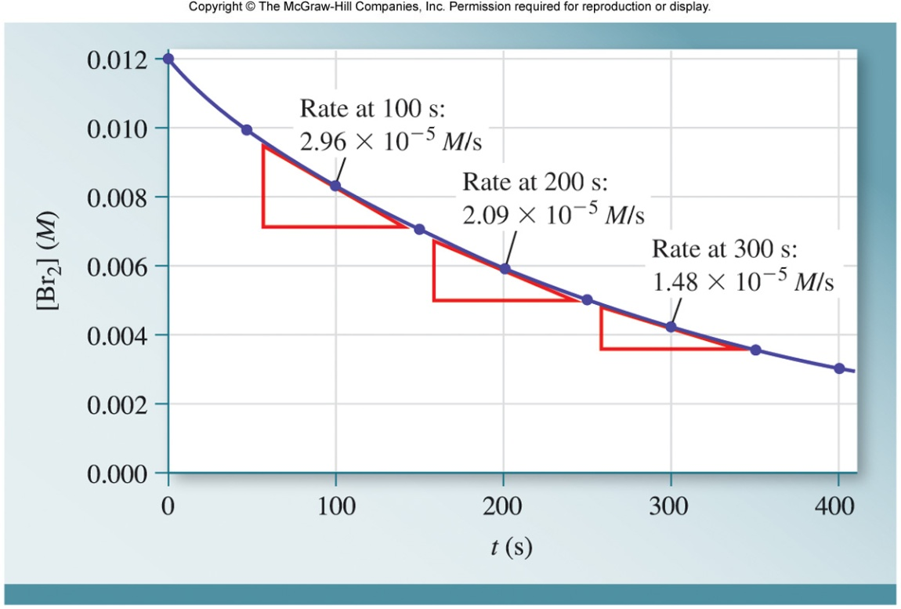
Instantaneous Rate
Plot of [Br₂] vs time = curve
Plot of Rate vs [Br₂] = straight line
Instantaneous: rate at a specific instant in time (slope of a tangent to the curve)

Slide 6
Rate Constant, k
Using data from Table 5.1 - what can you conclude?
Time (s)
[Br₂]
Rate (M/s)
50
0.0101
3.52 x 10⁻⁵
250
0.00596
1.75 x 10⁻⁵
Answer:
When the [Br₂] is halved; the rate is halved
Rate is directly proportional to [Br₂]
rate = k [Br₂]
k = proportionality constant and is constant as long as
temperature remains constant

Slide 7
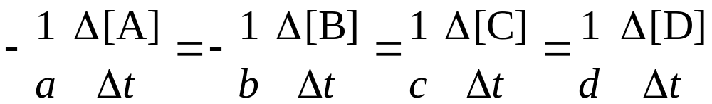
Stoichiometry and Reaction Rate
When stoichiometric ratios are not 1:1 rate of reaction is expressed as follows
General equation:
aA + bB → cC + dD
rate =

Slide 8
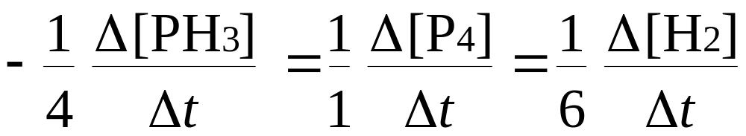
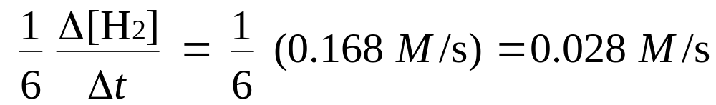
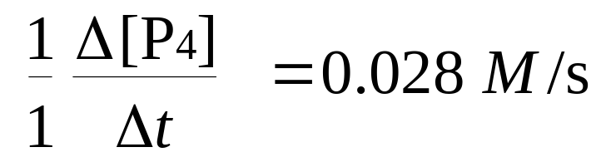
Example: 4PH₃(g) → P₄(g) + 6H₂(g).
If molecular hydrogen is formed at a rate of 0.168 M/s, at what rate is P₄ being produced?
Answer
Rate =

Slide 9
Rate Law
In general, rates of reactions increase as concentrations increase since there are more collisions occurring between reactants.
The overall concentration dependence of reaction rate is given in a rate law or rate expression.
Rate law relates rate of the reaction to the reactant concentrations and rate constant
Here’s what a general rate law for the general reaction, will look like…
aA + bB → cC + Dd
Rate = k [A]^{x} [B]^{y}
  - [A] & [B] represent the reactants.
  - The exponents x and y are called “reaction orders”.
  - The proportionality constant k is called the rate constant.
  - The overall reaction order is the sum of the reaction orders.
  - The overall “order of reaction” is therefore…
  x + y + ….

Slide 10

Rate Law Example
Consider the following reaction:
NH₄⁺(aq) + NO₂⁻(aq) N₂(g) + 2H₂O(l)
Let’s say that the following observations from several experiments were made…
  as [NH₄⁺] doubles the rate doubles with [NO₂⁻] constant.
  as [NO₂⁻] doubles the rate doubles with [NH₄⁺] constant.
The rate of this reaction would be expressed as….
Rate = k[NH₄⁺][NO₂⁻]
The reaction is said to be “first order” with respect to [NH₄⁺] and “first order” with respect to [NO₂⁻].
But the overall order of the reaction is said to be “second order.”
Order of reaction come from experiment data, not stoichiometry!

Slide 11
Order of Reactions
Only determined via experimental data
Sum of exponents (order) indicates overall reaction order
A reaction is zero order in a reactant if the change in concentration of that reactant produces no effect.
A reaction is 1st order if doubling the concentration causes the rate to double.
A reaction is 2nd order if doubling the concentration causes a quadruple increase in rate.
3rd order doubling concentration leads to 2³ (or 8 times) the rate.
Note-- The rate constant, k, does not depend on concentration!
Once we have determined the rate law and the rate constant, we can use them to calculate initial reaction rates under any set of initial concentrations.

Slide 12
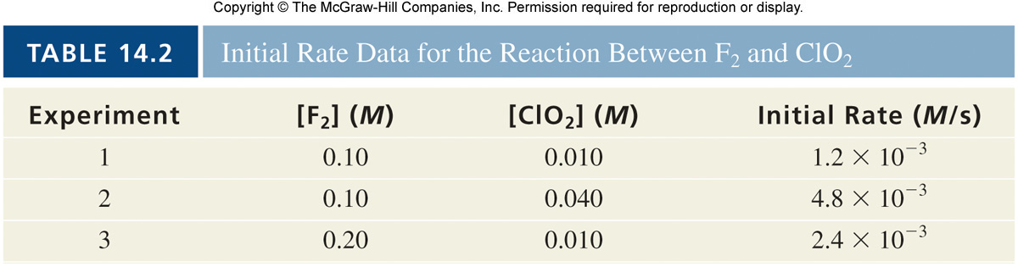
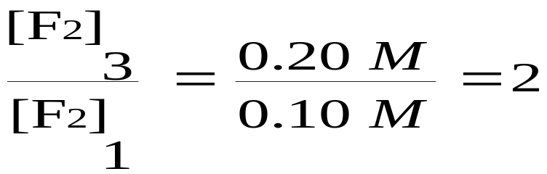
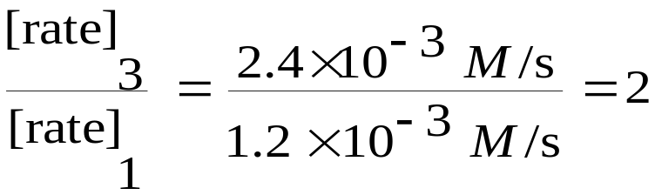
Experimental Determination of Rate Law
Method of initial rates - examine instantaneous rate data at beginning of reaction
Table 5.2
rate = k[F₂]^{x} [ClO₂]^{y}
Find order (exponents) by comparing data
Exp. 1 and 3: [ClO₂] is held constant
1st order with respect to [F₂] (rate and M directly related)

Slide 13
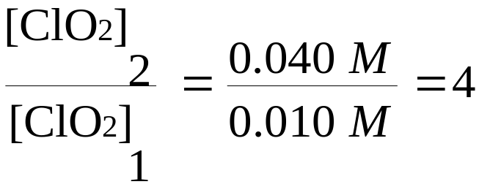
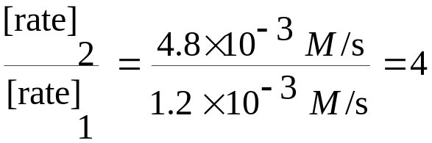
rate = k[F₂]¹[ClO₂]^{y}
Find order (exponents) by comparing data
Exp. 1 and 2: [F₂] is held constant
1st order with respect to [ClO₂] (rate and M directly related)

Slide 14
Determining Rate Law
Exp.
[A] (M)‏
[B] (M)‏
Initial
Rate(M/ s)
1
0.10
0.015
2.1 x 10⁻⁴
2
0.20
0.015
4.2 x 10⁻⁴
3
0.10
0.030
8.4 x 10⁻⁴
What is Different?
In experiment 1 and 2; [B] is constant; [A] doubles and rate doubles - the reaction is 1st order with respect to [A]
In experiment 1 and 3; [A] is constant; [B] doubles but the rate quadruples! This means that the reaction is 2nd order with respect to [B]

Slide 15
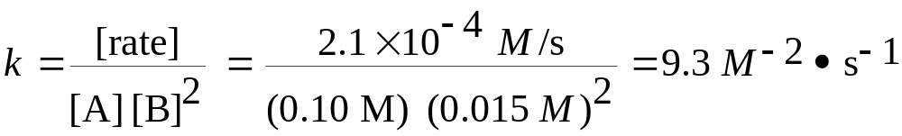
Calculate the Rate Constant
Rate = k[A] [B]²
The rxn is first order with respect to [A]
The rxn is second order with respect to [B]
The rxn is third order overall (1 + 2)

Slide 16
5.2.Integrated Rate Law
Allows us to determine information about concentrations over time,
not just at a particular instant during the reaction.
With the integrated rate law we can determine how long it will take
to use up a reactant, form a product, etc.
Integrated rate laws come from setting the rate law and rate
expression equal to each other for each order, and integrating over
time.

Slide 17
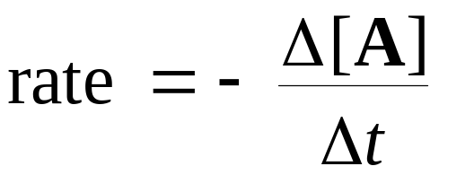
1. Zero Order
A → product : Rate = k[A]⁰ = k and
Rate does not change with concentration.
So… [A]_{t} = -kt + [A]₀
where [A]_{t} = concentration of [A] after some time, t
k= reaction rate constant in units of M/s
t= time in seconds
[A]_{o} = initial concentration of A
This equation has the general form for a straight line, y=mx+b, so a plot of [A]_{t} vs. t is a straight line with slope (-k) and intercept [A]₀.
Half-life: the time that it takes for the reactant concentration to drop to half of its original value.
For Zero order reactions… t_{½} = [A]₀ /2k
[A]_{t}
Time(s)

Slide 18
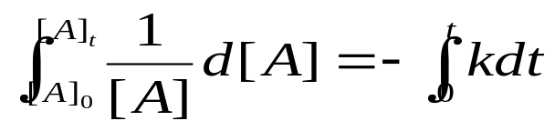
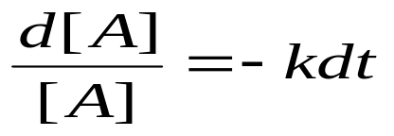
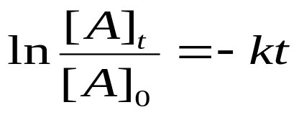
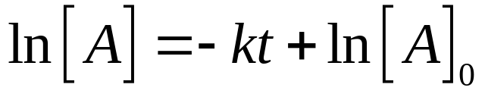
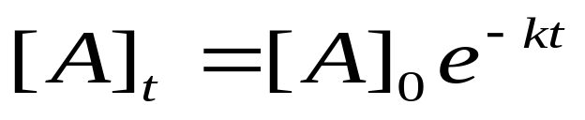
2. First-Order reactions
may be expressed in several ways
Example: A → products
rate = k[A]
When the two expressions are set equal to each other and integrated, we get an expression that can be rearranged in the form of a straight line.
First order reactions decay exponentially.

Slide 19
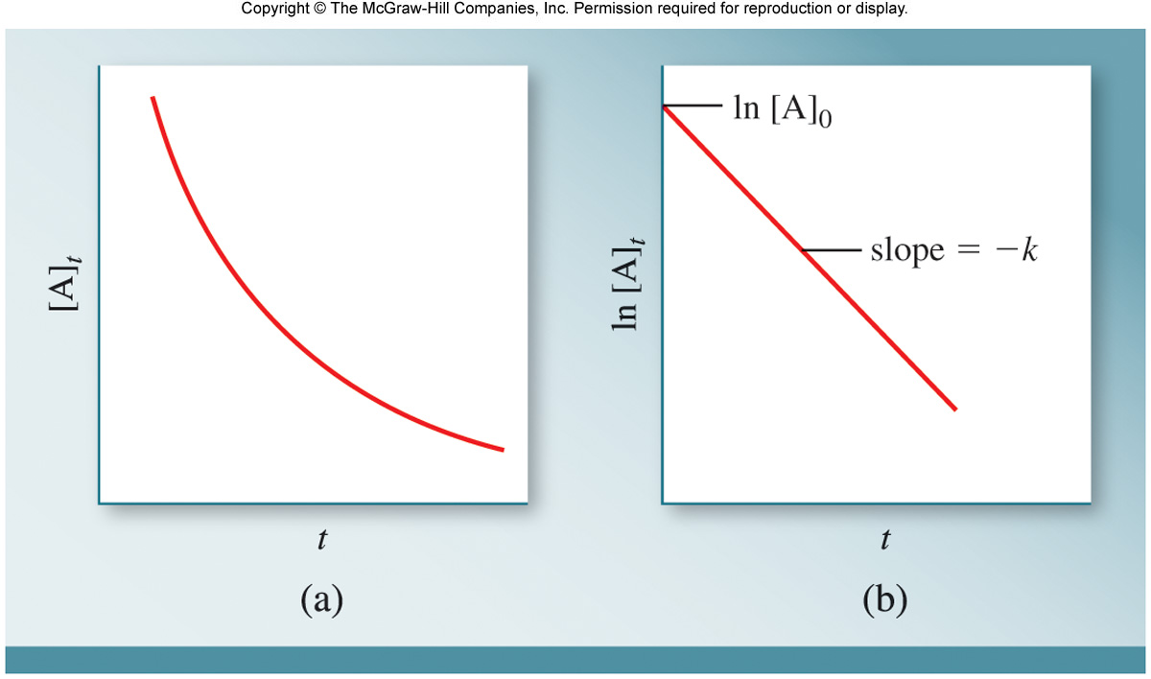
Given concentration and time data, graphing can determine order
For a 1st order reaction, a plot of ln [A] vs time yields a straight line
The slope = −k (the rate constant)

Slide 20
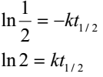

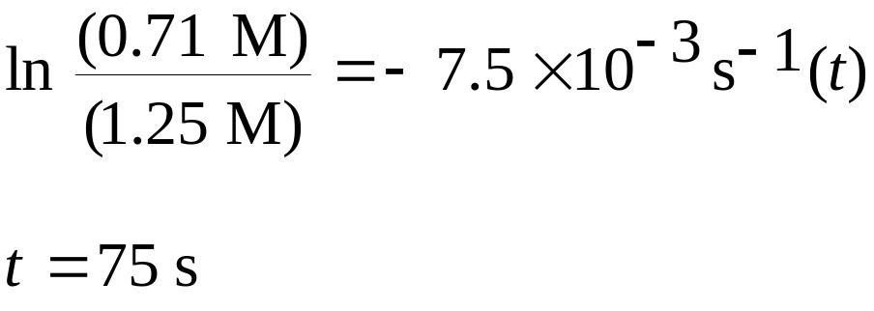
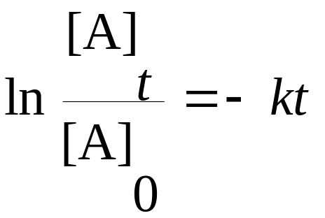
Half-life
The half-life, usually symbolized by t_{1/2}, is the time required for [A] to drop from its initial value [A]_{o} to [A]_{o}/2.
Using the integrated form of the first order rate law we find that
Example: 1.The rate constant for the reaction
2A → B is 7.5 x 10⁻³ s⁻¹ at 110°C. The reaction is 1st order in A. How long (in seconds) will it take for [A] to decrease from 1.25 M to 0.71 M?

Slide 21
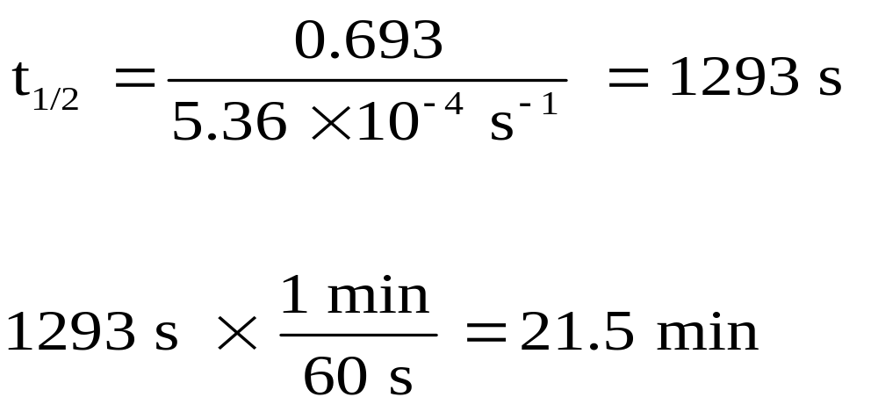
2. The decomposition of ethane (C₂H₆) to methyl radicals (⋅CH₃) is a first order reaction with a rate constant of 5.36 x 10⁻⁴ s⁻¹ at 700 °C. Calculate the half-life in minutes. C₂H₆ → 2CH₃
Exercise:
A first order reaction is 24 % complete in 20 minutes. How long will the reaction take to be 85.5 % complete? Calculate the rate constant for the reaction.

Slide 22
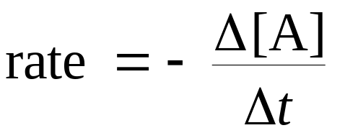
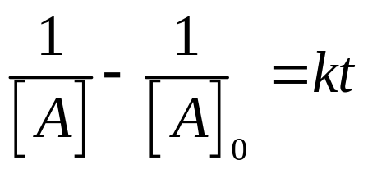
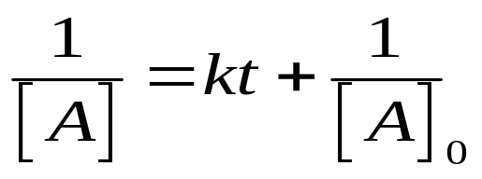
3. Simple Second Order Rate Equations
Second-order reactions may be expressed in several ways
Example: 2A → product
rate = k[A]²
Again, the relationships can be combined to yield the following relationship in the form of a straight line

Slide 23
where [A]_{t} = concentration of [A] after some time, t
k= reaction rate constant in units of M⁻¹s⁻¹
t= time in seconds
[A]_{o} = initial concentration of A
This equation has the general form for a straight line, y=mx+b, so a plot of l/[A]_{t} vs. t is a straight line with slope (k) and intercept of 1/[A]₀.
1
——
[A]
k
1
——
[A]_{o}
Time(s)

Slide 24
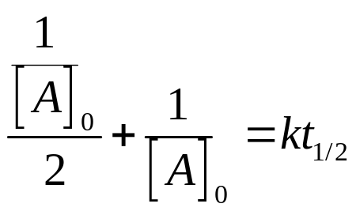
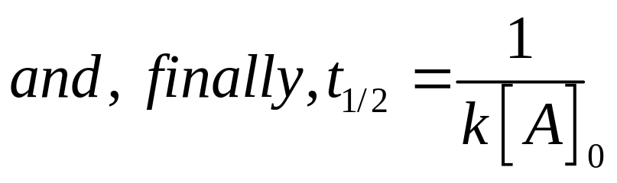
Half-life
We can define the half-life of a second order reaction in the same way as in first order reactions. That is, the half-life, t1/2, is the time required for [A] to fall from [A]_{o} to [A]_{o}/2.
Note that the half-life for a simple second order reactions depends on the initial concentration and that it is proportional to 1/[A]o. Contrast this to what we know about first order reactions where the half-life is independent of the initial concentration.

Slide 25
Example
1. A second order reaction is 20 % complete in 40 min when the initial concentration of the reactant is 0.10 M. Calculate (a) the rate constant, (b) the half life, and (c) the time it would take for the reaction to be 20 % complete if the initial concentration were 0.01 M
Solution
Using equation
When the reaction is 20% complete the amount of the reactant left is 80% of the original,

Slide 26
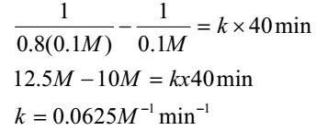
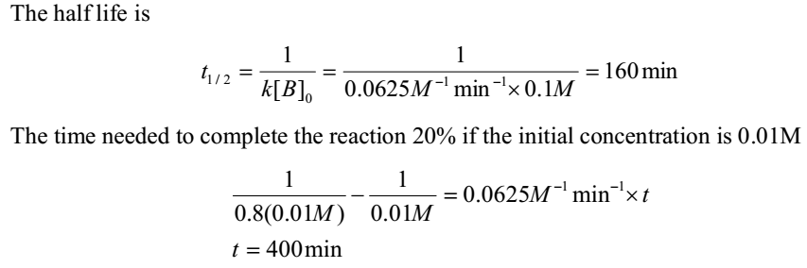

Slide 27
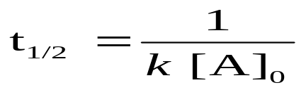
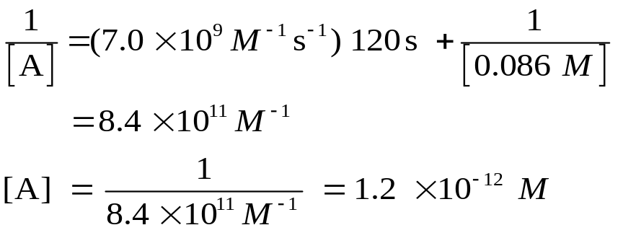
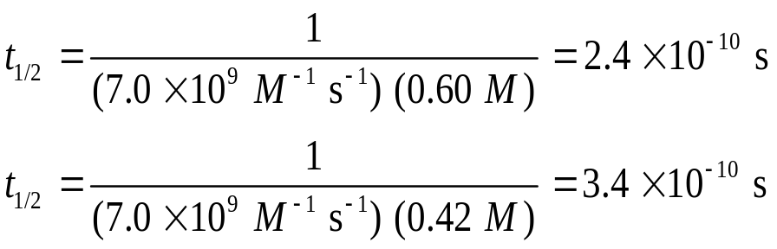
Calculation of half-life
2. The following reaction is second order and has a rate constant of
7.0 x 10⁹ M⁻¹ s⁻¹ at 23°C.
I(g) + I(g) → I₂(g)
a) If the initial [I] is 0.086 M, calculate the concentration after 2.0 min.
b) Calculate the half-life of the reaction when the initial [I] is 0.60 M
and when the [I] is 0.42 M.
b). Use the half-life formula for 2nd order (note: half-life does not remain constant for a 2nd-order reaction!)
Solution
a). Use integrated rate equation for 2nd order

Slide 28

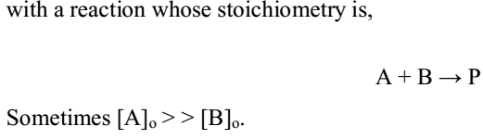
Pseudo First Order Reactions
That is when one of the reactants in the rate equation is present in great excess over the other in the reaction mixture.
As an example, let's look again at the mixed second order rate law that we treated in the last section. In the last section we had the rate law,

Slide 29
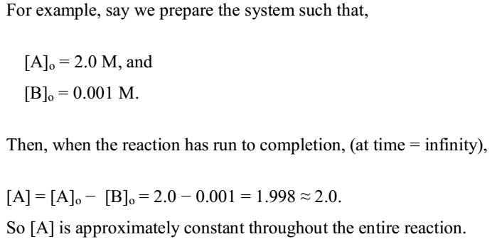
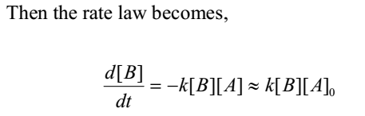

Slide 30
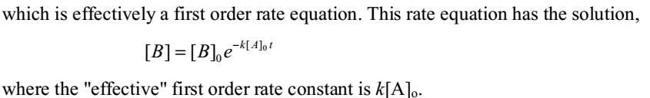
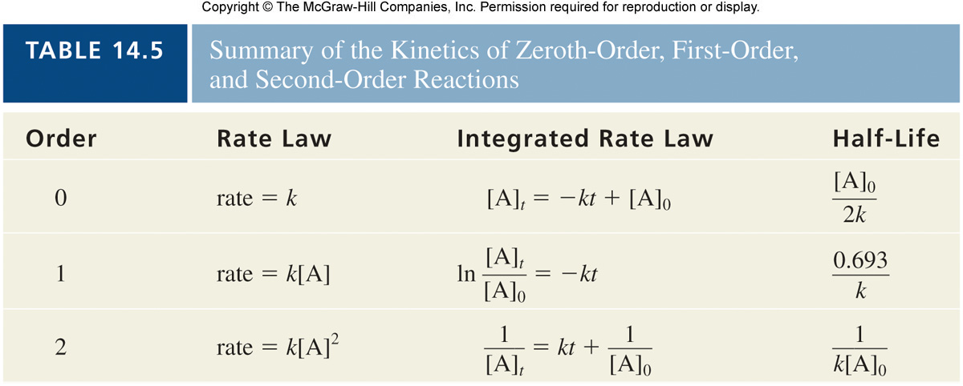

Slide 31



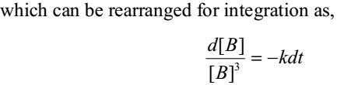
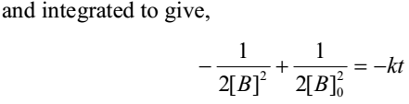
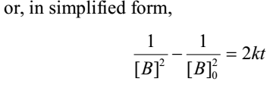
4.Simple Third Order Reaction

Slide 32
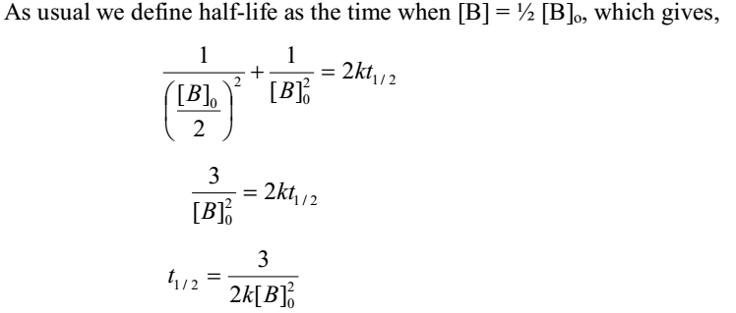
Note that in this case the half-life depends on 1/[B]_{o}² as opposed to depending on [A]o for a simple second order reaction, and being independent of [A]o for a first order reaction.

Slide 33
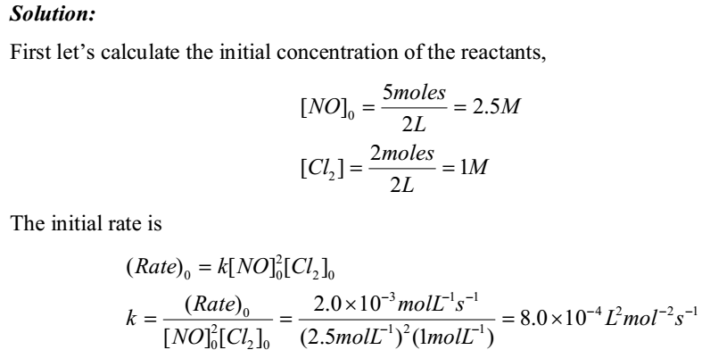
Example
The reaction 2NO(g) + Cl₂(g) → 2NOCl(g) is second order in NO and first order in Cl2. Five moles of NO and 2 moles of Cl₂ were brought together in a volume of 2L and the
initial rate was 2.0 x10⁻³ mol L⁻¹ s⁻¹.What will be the rate when one half of Cl₂ has reacted?

Slide 34
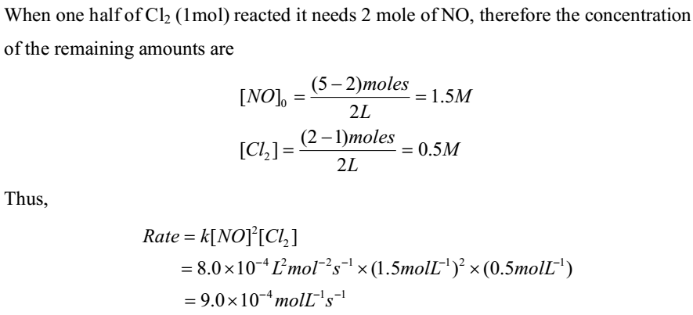

Slide 35
5.5.Theories of chemical reaction
Two theories are there
1.Collision theory and
2.Transition state theory

Slide 36
Collision Theory
Particles must collide in order to react
The greater frequency of collisions, the higher the reaction rate
Only two particles may react at one time
Many factors must be met:
  Orientation
  Energy needed to break bonds (activation energy)‏

Slide 37
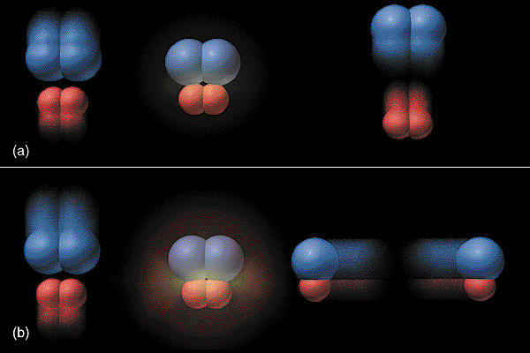
In order for particles to react,
They must collide

Slide 38

2. They must collide in the correct orientation to form the activated complex
Though it seems simple, not all collisions are effective collisions
Effective collisions: a collision that does result in a reaction.
Ineffective collisions: the collision that doesn’t result in a reaction.

Slide 39

3. They must collide with a specific minimum amount of energy (activation energy) to form the activated complex

Slide 40
A greater number of effective collisions can be achieved by anything that
  Increases the energy of the reactants
  Lowers the activation energy
  Produces more collisions per unit of time
Transition state theory
Product to be formed from a reaction, there must be formation of activated complex.
The activated complex is a temporary, unstable arrangement of atoms that may lead to products
  It can be thought of as a transition state between reactants and products

Slide 41

Activation Energy
Activation energy - the minimum energy needed to make a reaction happen.
Activated Complex or Transition State - The arrangement of atoms at the top of the energy barrier.
Activated complex
reactants
products

Slide 42
Arrhenius
Said that the reaction rate should increase with temperature.
At high temperature more molecules have the energy required to get over the barrier.
The number of collisions with the necessary energy increases exponentially.

Slide 43

The Arrhenius Equation
The dependence of the rate constant k, of a reaction on temperature best described by Arrhenius equation
lnk = lnA – E_{a} / R T
E_{a} = activation energy
R = universal gas constant
A = frequency factor T = Kelvin temp

Slide 44

Arrhenius Equation
A plot of ln k vs 1/T will give a straight line
The slope of line will equal −E_{a}/R
The activation energy may be found by multiplying the slope by “R”

Slide 45

Arrhenius equation
Another useful arrangement of the Arrhenius equation enables calculation of:
1) Ea (with k at two different
temperatures)
2) the rate constant at a different
temperature (with Ea, k and
temperatures)

Slide 46
Arrhenius equation
Use the data to calculate activation energy of the reaction mathematically
T (Kelvin)
k (s⁻¹)
400
2.9 x 10⁻³
450
6.1 x 10⁻²
500
7.0 x 10⁻¹

Slide 47

Arrhenius

Slide 48
Reaction Mechanisms
Most reactions occur in a series of steps
The balanced equation does not tell us how the reaction occurs!
There are often a series of steps which add together to give the overall reaction
The series of steps is the reaction mechanism

Slide 49
Reaction Mechanism
Consider:
2NO(g) + O₂(g) → 2NO₂(g)
The reaction cannot occur in a single step.
One proposed mechanism:
Step 1: NO + NO → N₂O₂
Step 2: N₂O₂ + O₂ → 2NO₂

Slide 50
Reaction Mechanism
N₂O₂ is an intermediate in the reaction mechanism
Intermediate: a substance that is produced in an early step and consumed in a later step
Energy of activation must be overcome to form intermediates
Elementary reaction: one that occurs in a single collision of the reactant molecules

Slide 51
Reaction Mechanism
Molecularity: the number of reactant molecules involved in the collision
Unimolecular: one reactant molecule
Bimolecular: two reactant molecules
Termolecular: three reactant molecules (fairly rare)

Slide 52
Rate Determining Step
If the elementary reactions are known, the order can be written from the stoichiometric coefficients of the rate-determining step
Rate-determining step: the slowest step in the mechanism

Slide 53
Rate-Determining Step
Steps of a mechanism must satisfy two requirements
  Sum of elementary steps must equal the overall balanced equation
  The rate law must have same rate law as determined from experimental data

Slide 54
Catalysis
Catalyst - a substance that increases the rate of a chemical reaction by lowering activation energy without being used up itself
Provides a set of elementary steps with more favorable kinetics than those that exist in its absence

Slide 55

Reaction Pathway with Catalyst
uncatalyzed
catalyzed

